Slide 1
COLLEGE FORUM

Slide 2
SYSTEM ARCHITECTURE
User Module
Viewing the upcoming events
Club Admin Module
Add, Update and Delete events
Accessing details of clubs/associations
Login to register for events
Add Recruitment Details including link
Send email to all the participants of an event
Main Admin Module
Add and update clubs/associations
Delete clubs
Reset Password
Reset Password

Slide 3
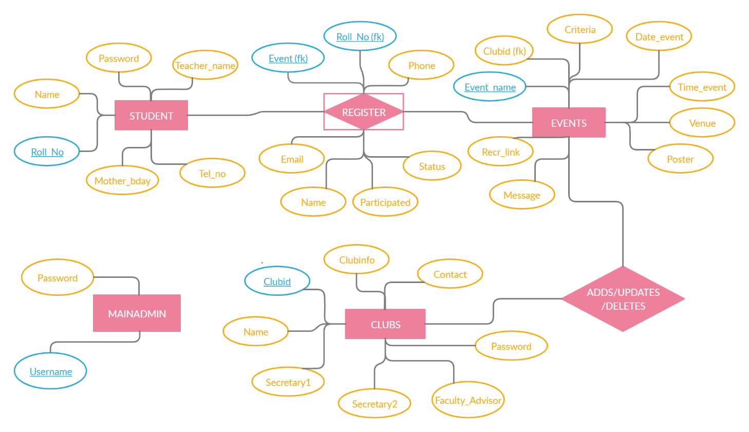
ER - DIAGRAM
N
N
N
1

Slide 4
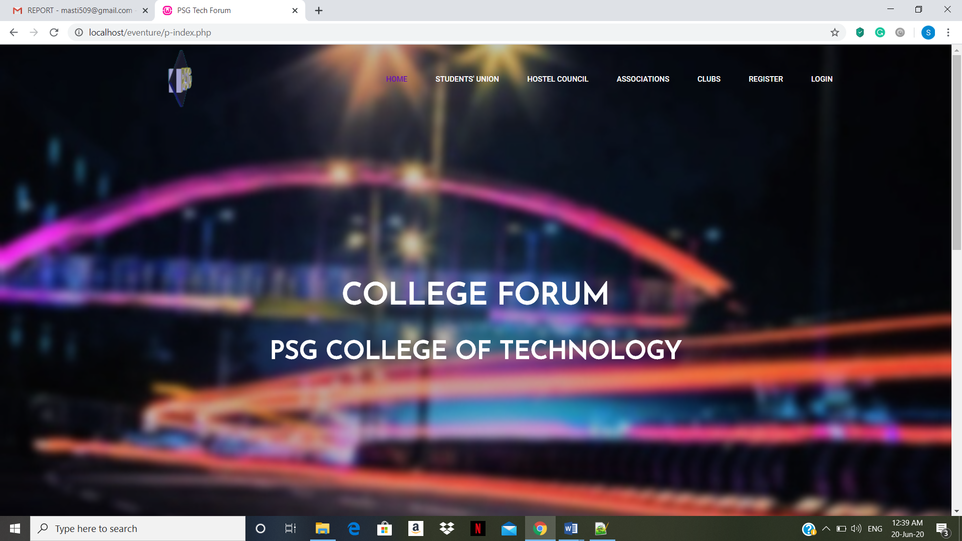
HOME PAGE

Slide 5
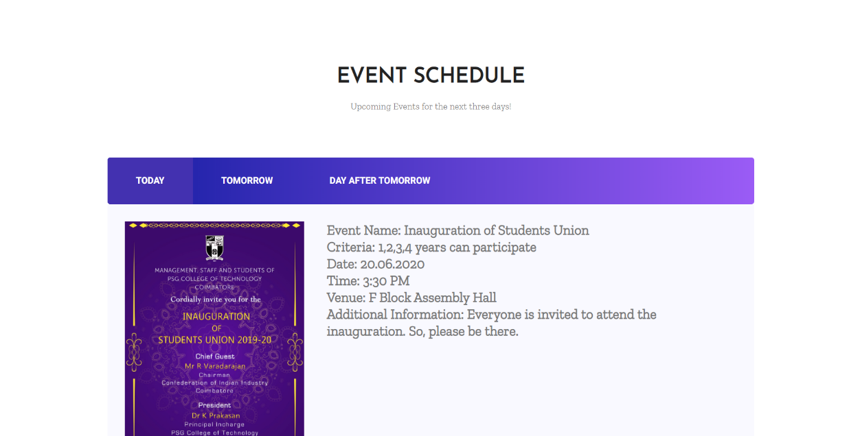
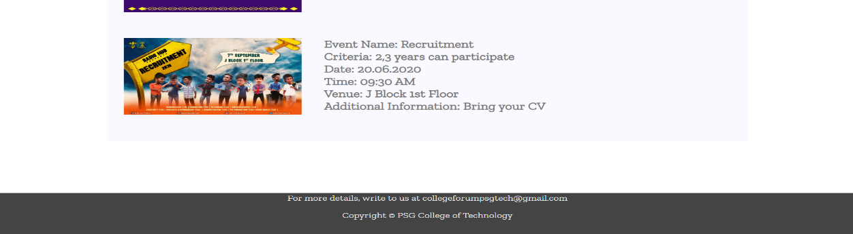

Slide 6
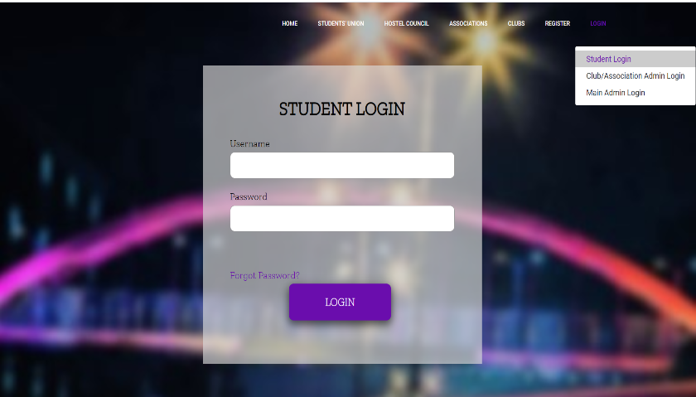
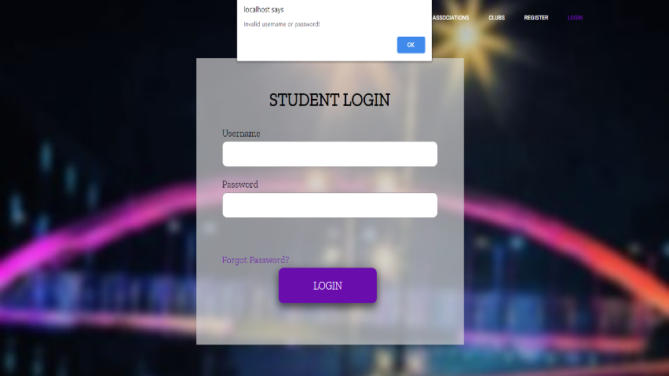
LOGIN AND LOGOUT

Slide 7
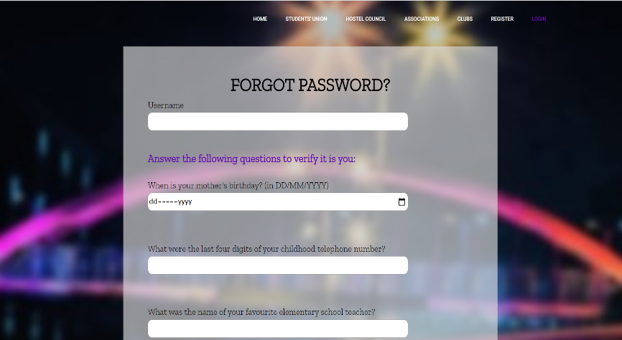
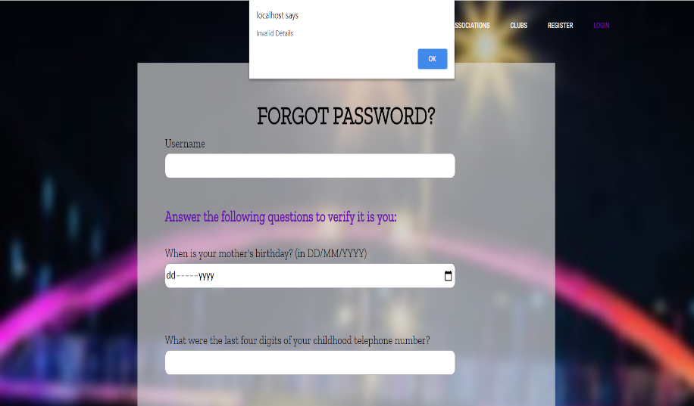

FORGET PASSWORD

Slide 8
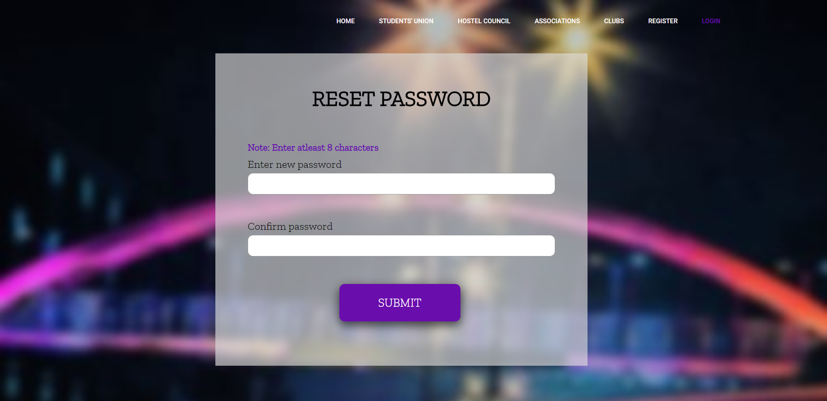
RESET PASSWORD

Slide 9
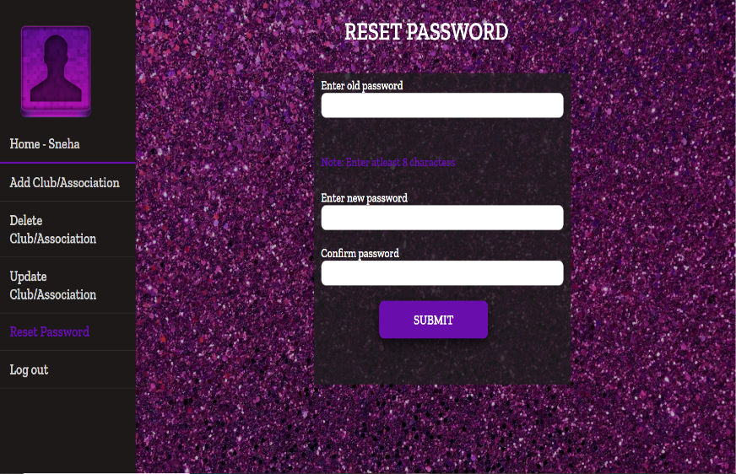
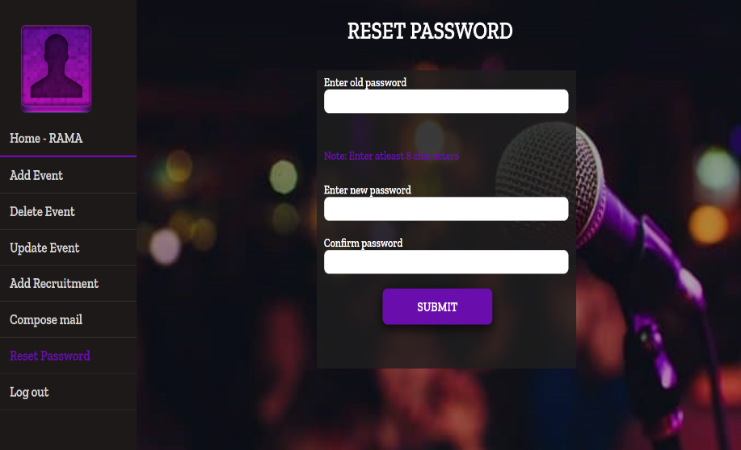
FOR MAIN ADMIN
FOR CLUB ADMIN

Slide 10
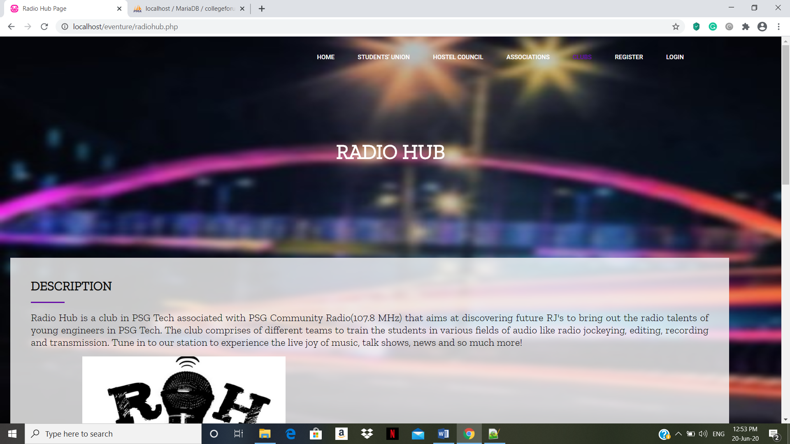
CLUB/ASSOCIATION

Slide 11

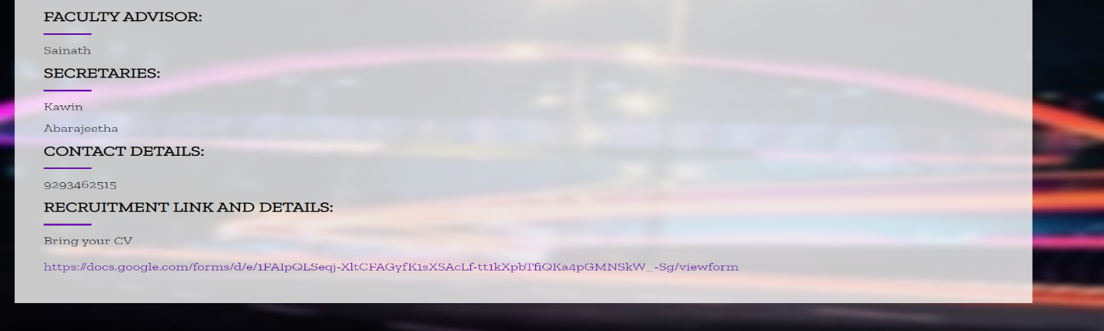

Slide 12
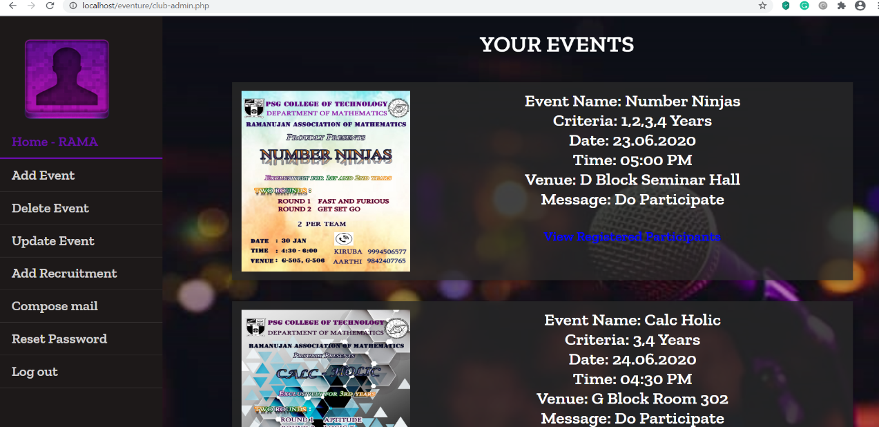
CLUB ADMIN

Slide 13
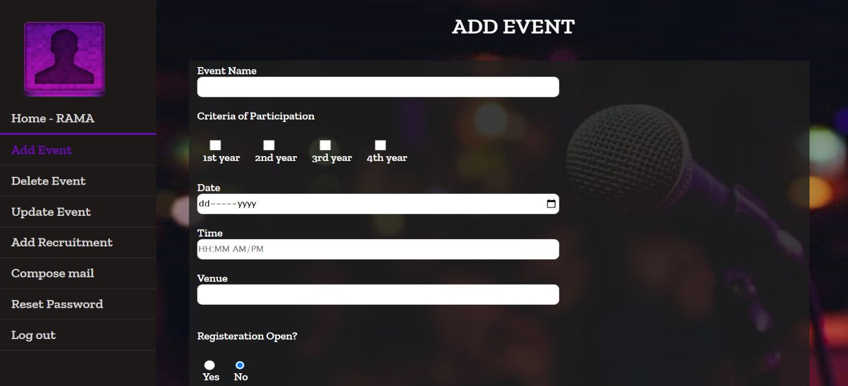
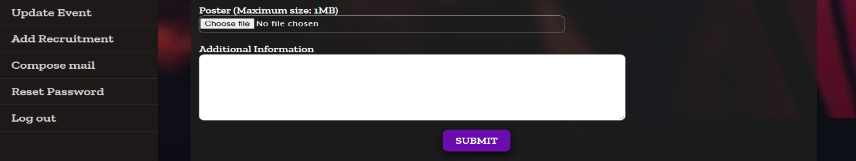
ADD EVENT

Slide 14
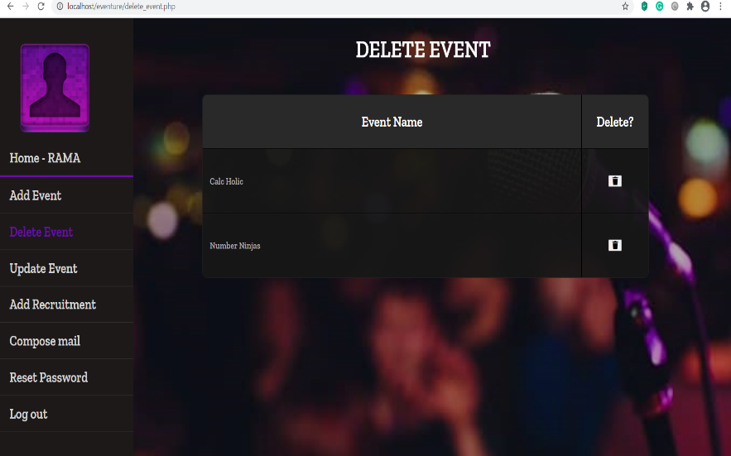
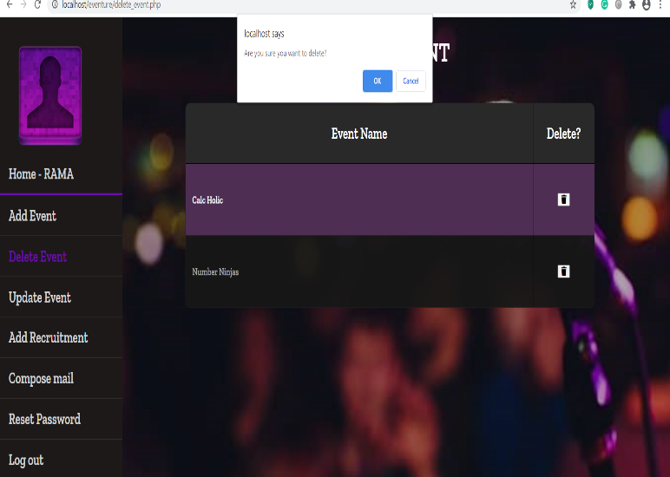
DELETE EVENT

Slide 15
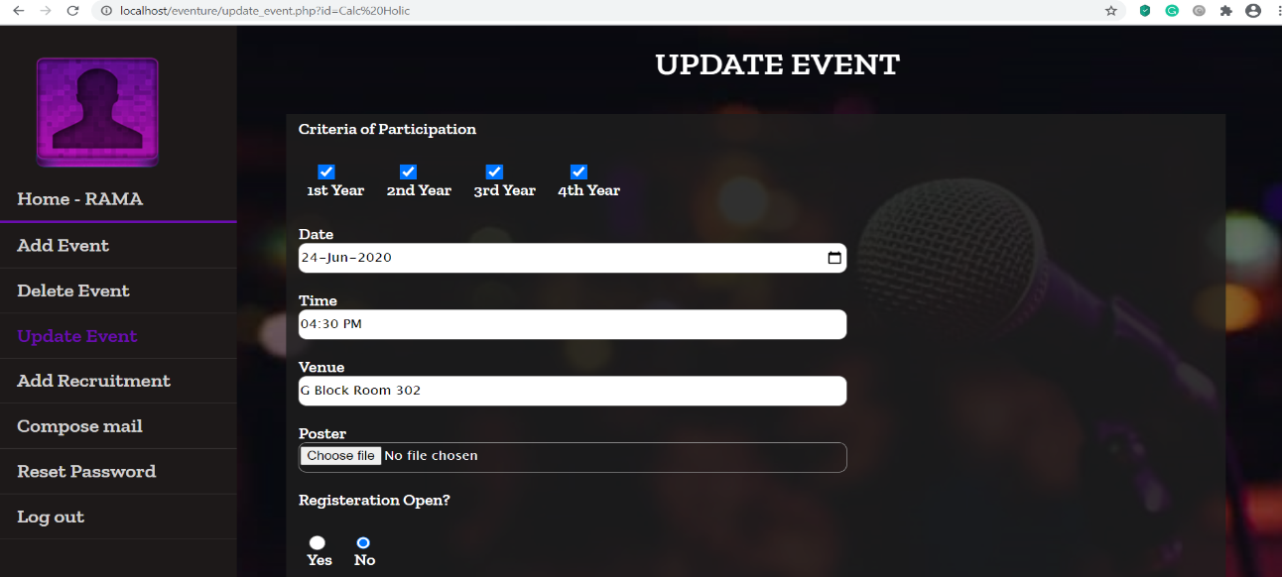
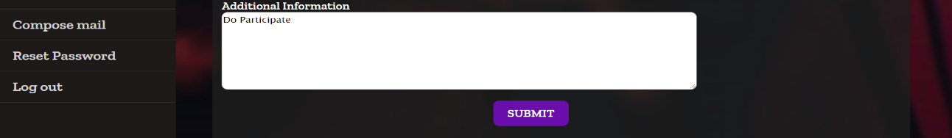
UPDATE EVENT

Slide 16
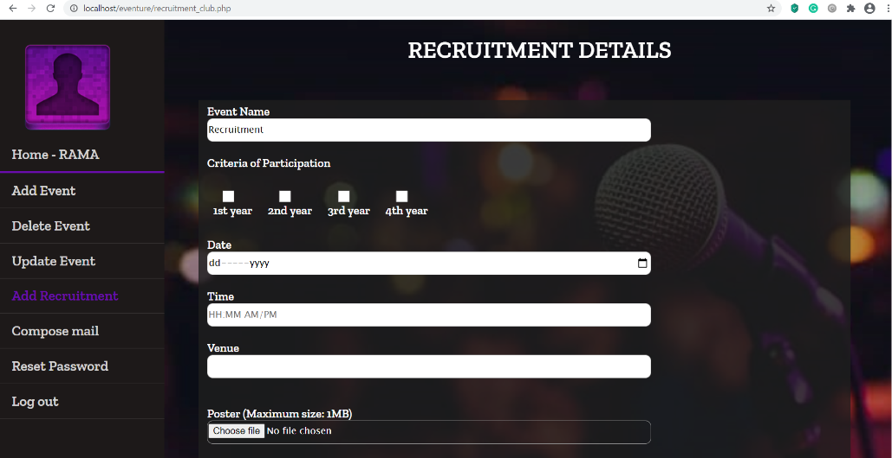
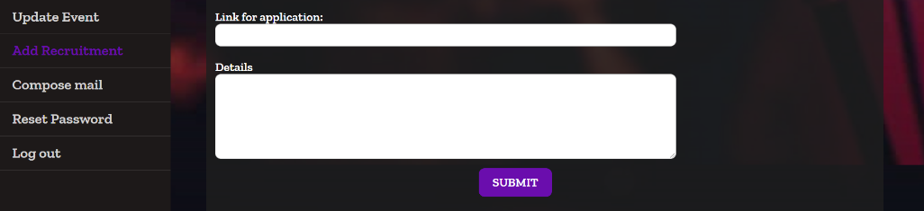
ADD RECRUITMENT

Slide 17
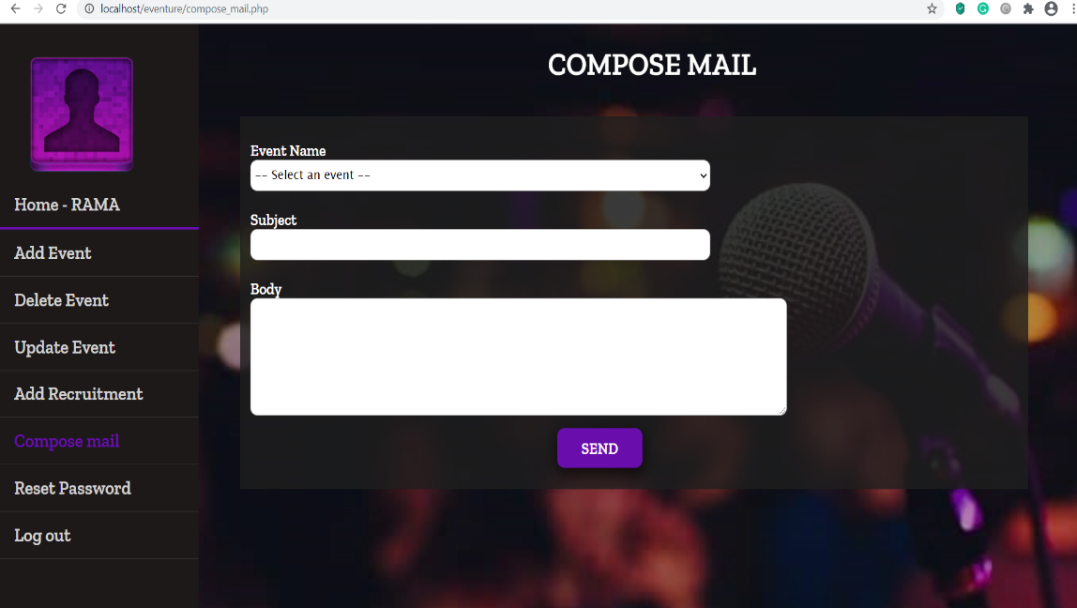
COMPOSE MAIL

Slide 18
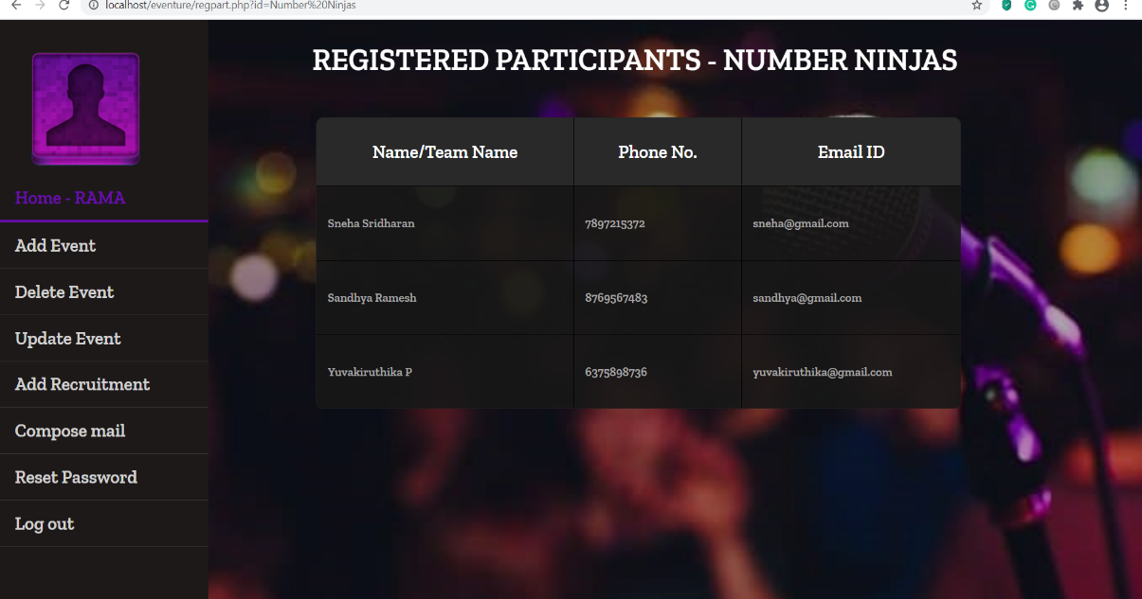
VIEW REGISTERED PARTICIPANTS

Slide 19
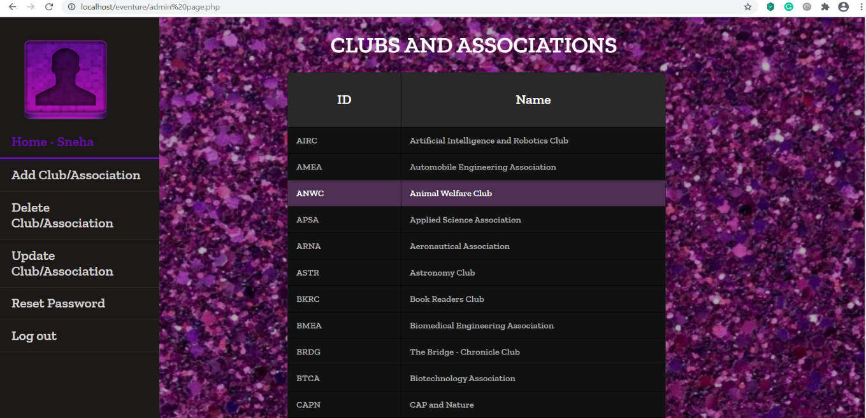
MAIN ADMIN

Slide 20
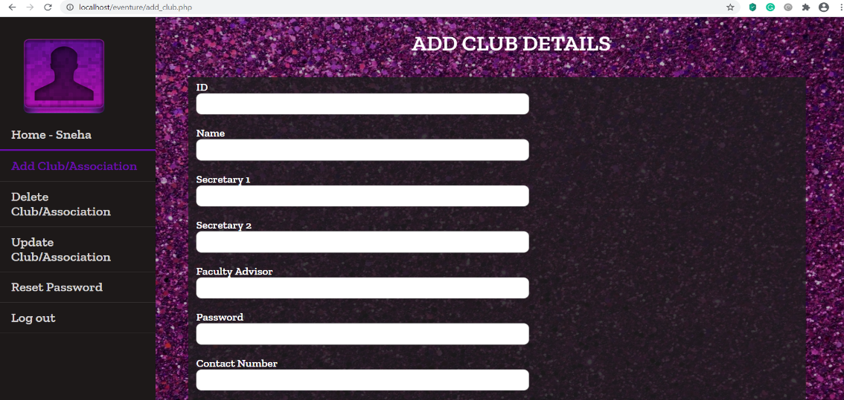
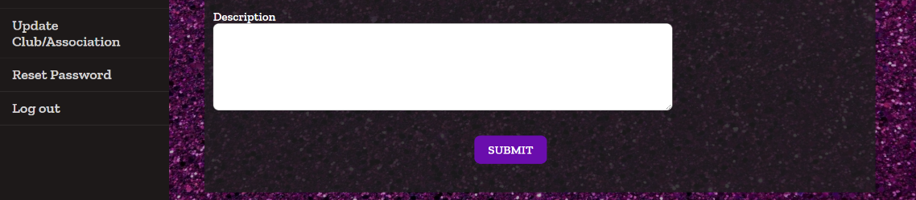
ADD CLUB

Slide 21
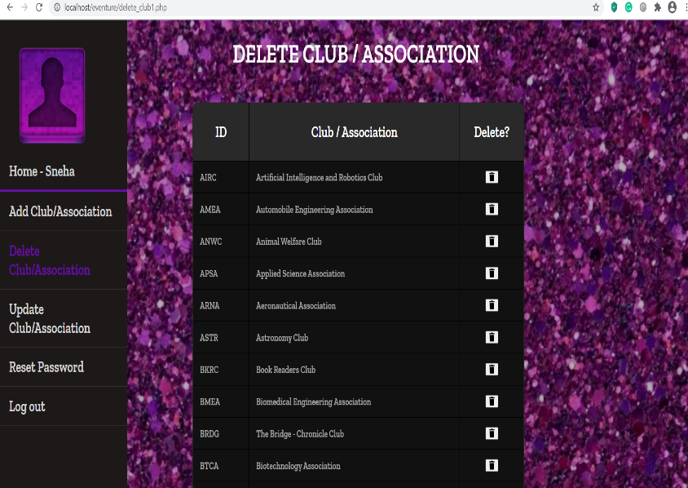
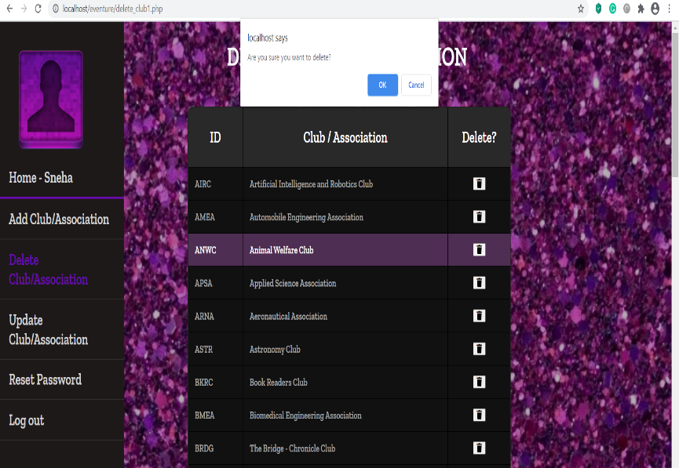
DELETE CLUB

Slide 22
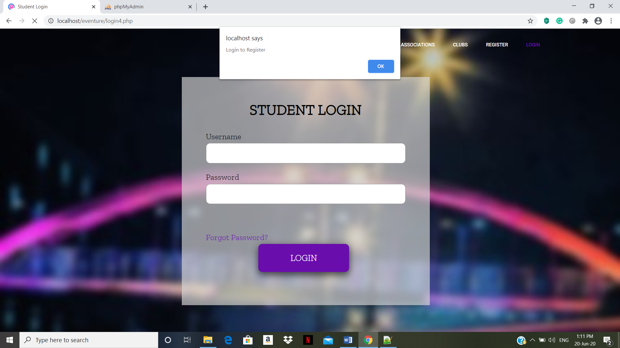
REGISTRATION
STEP1:LOGIN

Slide 23
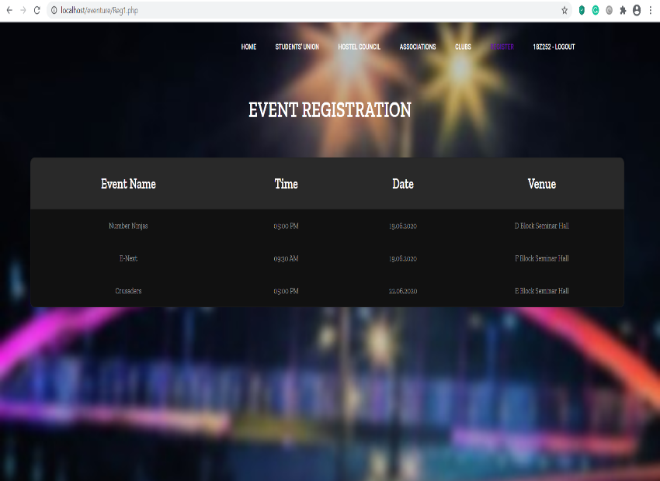
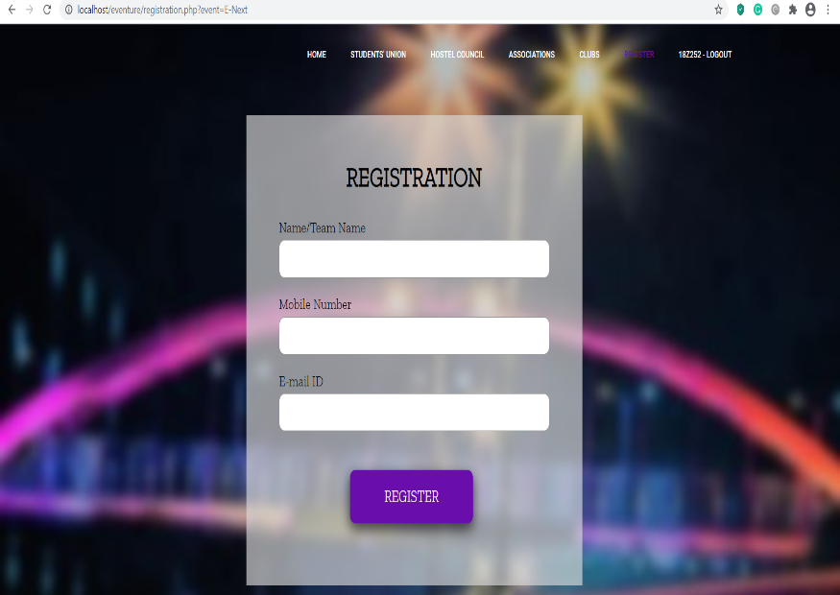
STEP2:CHOOSE A EVENT TO REGISTER
STEP3:FILL YOUR DETAILS TO REGISTER

Slide 24
The user is logged in the system and is allowed to access the main page. And also the message for the invalid login .
The user is redirected to Login window
Login
Clubs/ Associations pages
Home page
Add/ update/ delete event
Recruitment
Add/ update/ delete club
Modules
Directed to a form to be filled with details regarding the club/associatio n to be added
Directed to a webpage of the chosen club/association with description, contact information
The club admin is directed to a page to add details regarding the recruitment
Directed to a form to fill in details of the event to add or delete or update

Slide 25
Thank you

